Slide 1
MODULE 5
Device Driver

Slide 2
What is Device Driver ?
A Device Driver is glue between an OS and its I/O devices.
Act as Translators, converting generic requests received from the operating system into commands that specific peripheral controller can understand
The application software makes system call to OS.
OS analyzes these request and issues request to device driver.
Device drivers communicate directly with devices by issuing commands to perform the operation needed to service equest.
A device is a physical or logical entity that requires control, resource management, or both from the operating system (OS).

Slide 3
A device driver is a software module that manages and controls the operation of a virtual or physical device.
Device driver simplifies the operation of OS
A UNIX device driver is a collection of functions written in C that can be called by OS using C Standard function calling mechanism.
These routines are often refered as entry points.
Device drivers are part of the OS kernal (drivers are software module that are built separately and plugged in to kernel when needed)
Each piece of code that can be added to the kernel at runtime is called a module

Slide 4
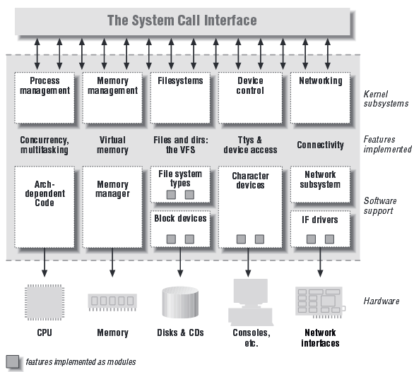
Split view of kernel

Slide 5
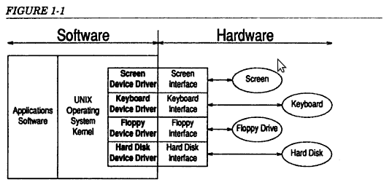
What is Device Driver ?

Slide 6
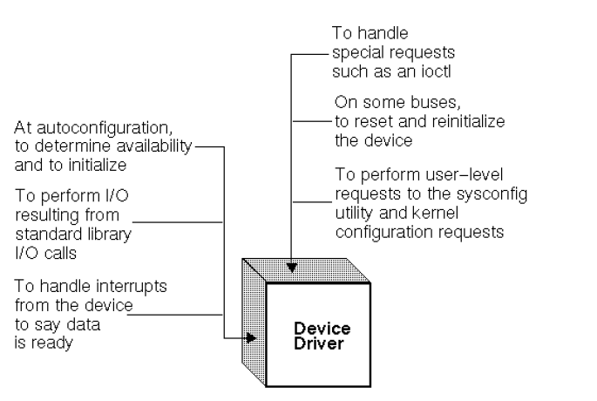

Slide 7
Advantage of Device drivers
Simplifies the working of OS
Without a device driver, Os would be responsible for talking directly to the hardware which add extra overhead to OS
If device drivers are absent, then adding support for a new device requires modification of the OS
Individual hardware request can be ignored and OS can give generic request to the device drivers.
A device driver takes device independent request from OS and convert in to hardware request
DEVICE DRIVER
Device independent request from OS
Hardware request

Slide 8
Major Design Issue
OS / Driver Communication
  Exchange information (command and data)
  Support functions that the kernel provides
Driver / Hardware Communication
  Exchange information (command and data)
  Software talks to the hardware
  Hardware talks to the software
Driver Opertaions
  Interrupting ,scheduling, managing, read, write, accepting

Slide 9
Types of Device Drivers
Block Drivers
Character Drivers
Terminal Drivers
Stream Drivers

Slide 10
Block Drivers
It communicate with OS through a collection of fixed-sized buffers.
Os manages a cache of these buffers and attempt to satify user requests for data by accessing buffers in the cache.
The driver is invoked only when the requested data not in the cache or when buffers in the cache have been changed and must be written out.
Drivers handle requests from the OS to fill or empty fixed-sized buffers.
Example:Block drivers are used primarily to support devices that contain file system ( such as hard disks).

Slide 11
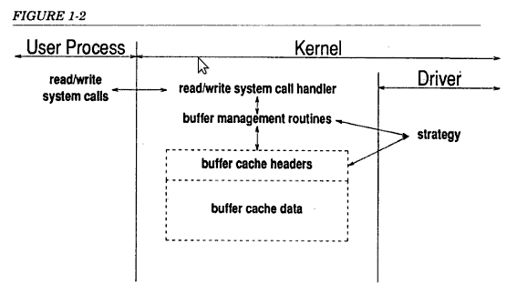

Slide 12
Character Drivers
It can handle I/O requests of arbitary size and can be used to support almost any type of devices.
This drivers are used for devices that either deals with data a byte at a time or in chunks smaller or larger than the standard fixed size buffers used by blockdrivers (E.g. Printer,Analog to digital converters, tape drives).
I/O request is passed directly to the driver and driver is responsible for transferring the data directly to and from the user process’s memory
Difference between block drivers and character drivers
  User processes interact with block drivers only indirectly through the buffer cache whereas user processes interact directly with character driver.

Slide 13
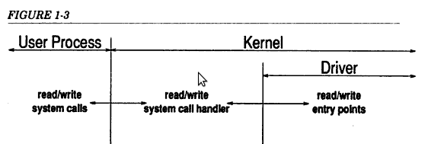

Slide 14
Terminal Drivers
Same as character drivers to deal with communication terminals that connect users to OS. (E.g. MODEM)
Drivers are responsible not only for shipping data to and from user’s terminals but also for handling line editing and many othe terminal functions that are part of terminal interface.
Terminal drivers are responsible for a lot of data processing.
Most drivers only have to manage the flow of data to and from the device,leaving any processing to kernel and user process whereas terminal drivers must handle processing like conversion of carriage return to new lines,the conversion of tabs to space,the processing of erase and more

Slide 15
Kernel provides routines to perform most of the processing required of a terminal driver.
Line Disciplines
  Kernel provide this routine to assist terminal drivers with character processing.
  Line discipline is a collection of routines related to terminal processing.
  The system provide a standard line discipline and programmer can add additional ones. Properly written terminal drivers references the standard line discipline

Slide 16
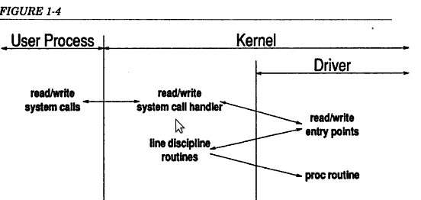

Slide 17
STREAM Drivers
It can handle high speed communication devices such as networking adapters that deal with unusal sized chunks of data and that need to handle protocol.
It is also known as Network Device Drivers.
It is an extension to the character driver model.
eg. Network Device
Stream head handles interface between the stream & user process and 0 or more stream module implement various protocol layers.
Data from the user process flow downstream from the stream head through the 0 or more protocol module(stream module) to the driver.
The received data from driver flows upstream from the driver to stream module(necessary protocol processing is performed ) to stream head & from there to user process.

Slide 18
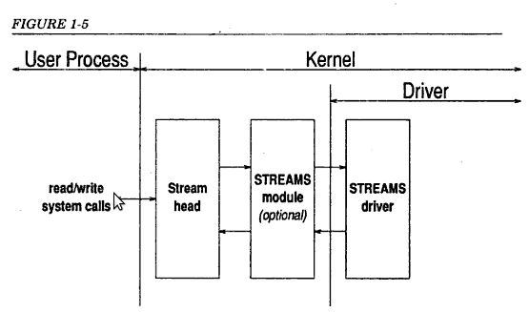

Slide 19
Anatomy of device drivers
Driver is a set of entry points (routines) that can be called by the operating system.
A driver can also contain:
  data structure private to the drivers.
  references to kernel data structures external to drivers.
  and routines private to the driver(i.e. not entry points)
Most drivers are written as single source file.
The initial part of the driver is sometimes called the prologue.

Slide 20
The prologue is everything before the first routine and contains:
  #include directives referencing header files which defines various kernel data types and structures.
  #define directives that provide mnemonic names for various constants used in the driver(in particular constants related to the location and definition of hardware registers)
  Declaration of variables and data structures.
The remaining part of the driver are the entry points ( C functions referenced by the operating system) and routines (C functions private to the driver.)

Slide 21
Character Driver: Test data generator

Slide 22
Driver handles data byte by byte and reads arbitrary size
I/o request is passed unexchanged to the driver
Driver is responsible for transferring data to and from users to process ‘s memory.
Design issues of character drives:
  A) OS /driver interface
  B) Internal driver operation

Slide 23
A. OS/Driver interface
  1. OS calls one of the driver entry point. This cause control to pass to the device driver.
  2. The device driver examines the parameters passed and kernel data structures for information on exactly what to do.

Slide 24
A character driver may have any or all of the following entry points:
  Init()
  Start()
  Open(dev, flag,id)
  Close(dev,flag,id)
  Halt()
  Intr(vector)
  Read(dev)
  Write(dev)
  Poll(pri)
  ioctl(dev,cmd,arg,mode)

Slide 25
1.init()
  Called by the kernel immediately after the system is booted
  Used to initialize the driver and the hardware as well as to display messages announcing the presence of the driver and hardware
2. start()
  Called by kernel late in the bootstrap sequences.
  It also does initialization that require more system services than are available at the time when init is called.
3. open(dev, flag,id)
  Called by the kernel when user process performs an open system call on a special file that is related to the driver
  Perform initialllization prior to handling read and write system calls

Slide 26
4. close(dev,flag,id)
  Called by the kernel so that all opened files are closed
  Driver releases all resources and reset the device
5. halt()
  Called by kernel just before system is shut down and to flush data that is resident in the driver.
6. intr(vector)
  Called by kernel whenever an interrupt is received from the hardware
  Interrupt is a signal from the hardware that a significant event occur which requires the attention of the driver.
7. read(dev)
  Called by kernel whenever a user process performs a read system call on a special file related to driver.

Slide 27
  The driver accept the details of i/o request, perform the necessary operations to obtain the requested data and arrange for the transfer of the data to the user’s process.
8. write(dev)
  Called by kernel whenever a user process performs a write system call on a special file that is related to the driver.
  The driver accept the details of i/o request , arrange for the transfer of the data from the user’s process to the driver(or directly to the device) and perform necessary operation to write the data to the device
9. poll(pri)
  Called by the kernel 25 to 100 times a second
  Driver check on the status of device on a regular basis

Slide 28
ioctl (dev, cmd, arg ,mode)
  Called by the kernel whenever a user process performs a ioctl system call on a special file related to the driver.
  The driver is required either to accept the details of the ioctl request and perform the necessary operation or reject the request with an error.
  ioctl request are used to pass special request to the driver or to obtain information on the configuration or status of the device and driver.

Slide 29
B. Internal driver operation
A device driver is divided into two sections:
  Driver Prologue
  Entry points
Driver Prologue
  It includes all of the definition and declarations required by the driver.
  Three types of Prologue :
    Reference to the header files (Data types / Structures)
    Definitions that local for driver
    Declaration local to the Driver

Slide 30
Reference to the header files
  #include <sys/types.h>
    Contains the definition of various data types that are used by other include files and by the driver itself
  #include <sys/param.h>
    Contains the definition of various kernel parameters and macros that are needed by sys/user.h to size certain arrays
  #include <sys/dir.h>
    Contains the definition of the directory structure needed by sys/user.h
  #include <sys/signal.h>
    Contains the definition related to signals needed by sys/user.h
  #include <sys/errno.h>
    Contains the definition of the various error codes that may be returned from a driver
  All above header files are found in the directory /usr/include/sys

Slide 31
Driver entry point
The Init Entry Point
  called by the operating system shortly after the system is booted
  The primary purpose of calling the init routine is for the device driver:
    To check that the device is actually installed on the machine
    To print a message indicating the presence ( or absence) of the device and driver
    To initialize the device (if necessary) prior to the first open; and
    To initialize the driver and allocate local memory (if necessary) prior to the first open
The Read Entry Point
  called when the user’s process has requested data from the device using the read system call.
  This routine coordinate the transfer from the driver to the user’s process.

Slide 32
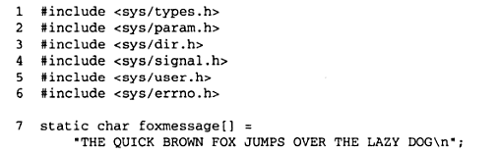

Slide 33

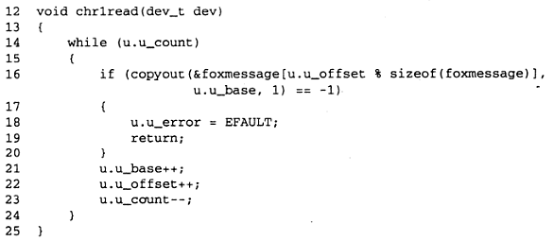

Slide 34
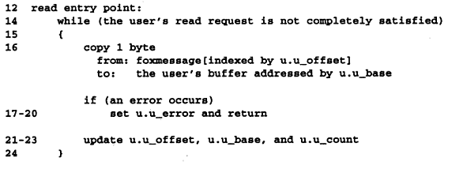

Slide 35
The User Area
  Every process has its own user structure
  Only the user structure for the currently executing process is accessible directly to the device driver
  Kernel variable u reference the user structure for the currently executing process
  E.g. The device driver can reference the u_base member of user structure for the current process by referring to u.u_base
  The contents of the user structure is defined by the system header file <sys/user.h>

Slide 36
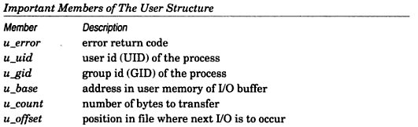

Slide 37
u.u_base contains an address in the user’s address space and device drivers runs in the kernel’s address space.
In line 7,the address of buffer is passed to the operating system. Os will take this address and put it into u.u_base before calling the device driver’s read routine
But this address is in terms of the current process’s address space and is not directly usable by the driver. So we call kernel for help
The routines copyin and copyout are provided by the kernel for device drivers in order to handle the transfer of data to and from user address spaces.

Slide 38
NOTE:
  While loop(line 14 to 24) continuous until u.u_count is zero
  Copyout is called to copy one byte from the Foxmessage string to user buffer
  If an error occurs(if copyout returns -1) we set u.u_error to report an error in the transfer and return prematurely(line 19)
  If u.u_error is set, the read system call in the user’s program will return -1 and the external variable errno, which is accessible to the user program will be set to the value of u.u_error (i.e., EFAULT)
  If the transfer succeeded, then update all of the u. variables
  Thus result of read entry point is that the data is transferred or an error is reported and u. variables are adjusted to reflect the data that was transferred.

Slide 39
Copyout takes:
  an address in kernel space where data is to be found
  An address in the user space of the current process where data is to be put
  Count of the number of bytes to transfer
Copyin takes:
  User address
  Kernel address
  Count
Both routines returns -1 if they encounter a problem transferring the data

Slide 40
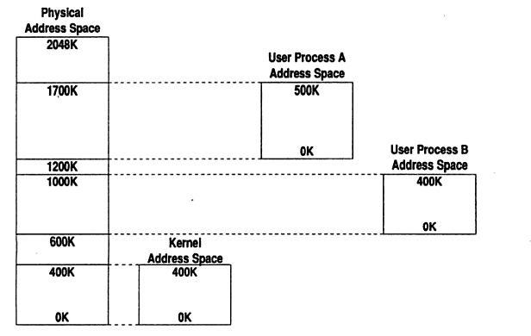

Slide 41
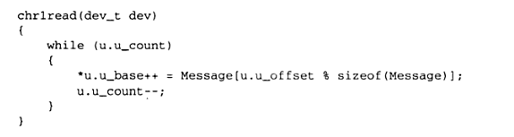

Slide 42
Example of Character devices (refer Text: Writing UNIX device drivers - George Pajari)
  A/D Converter (p.g 35)
  Line printers (p.g 55)
  The Raw Disk Driver (pg 147)
  A tape drive (pg 187)

Slide 43
Block Devices and Drivers

Slide 44
Difference between block drivers and character drivers
  Character drivers transfer data directly to and from the user’s process
  Block drivers transfer data to and from kernel’s buffer cache
  Block drivers are inappropriate for devices that typically perform I/O in variably sized blocks, possibly as small as a single byte while character drivers are ideally suited to such devices
  Character drivers cannot be used to support a device that contain a UNIX file system while block drivers are suited to such device
  Block drivers are ideally suited to support disk drives , hard disks
The purpose of kernel’s buffer cache is to optimize I/O to devices that handle data in blocks and can store UNIX file system

Slide 45
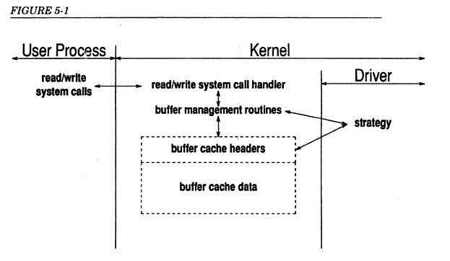

Slide 46
Design issues
  OS/Driver interface
  Internal operations of the driver
Os/driver interface
  init()
  start()
  open()
  close()
  halt()
  intr()
  poll()
  ioctl()

Slide 47
  print():
  responsible for reporting errors related to device driver
  strategy():
  read() and write() entry points are replaced by the strategy entry point that is responsible for both read and write request.
  Internal operations of the driver
    With block drivers all I/O requests come from the kernel in the form of requests to fill or empty buffers in the cache
    Buffer pointed by the buffer header is within the kernel address space. This means that special routines like copyin and copyout are not necessary.
    No tests are needed to handle errors that might occur during the transfer

Slide 48
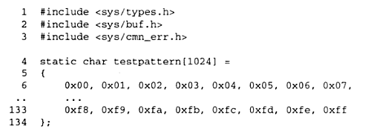
The Driver Prologue
The prologue of a device driver includes all of the definitions and declarations required by the rest of the driver.
Buf.h contains the definitions of the buffer header that are used to coordinate the transfer of data to and from block drivers
cmn_err.h contains definitions used by the error reporting routine that appear later in the driver

Slide 49

The Driver Entry Points
As a pseudo-driver that has no data structures needing to be initialized at boot time, init routine Merely announces the presence of the driver.

Slide 50
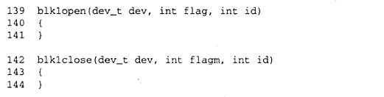
The Open and Close Entry Points

Slide 51
The strategy Entry Point
  One of the two entry point that exist in block drivers but not in character drivers (other is print entry point)
  It is responsible for handling requests for data (in or out) and replaces both the read and write entry point found in character drivers.
  Unlike the character drivers which look in the user(u.) area to determine the details of I/O request, block drivers are given a pointer to a buffer header that contains all of the necessary information describing the I/O operation (whether it is a read or write)
  This pointer is passed to the strategy routine when the kernel wishes to fill or empty a buffer in the buffer cache
  If the strategy routine cannot complete I/O immediately it merely returns
  When I/O operation completes , the block driver notifies the kernel by calling iodone(bp), passing it a pointer to the buffer that has been processed.

Slide 52
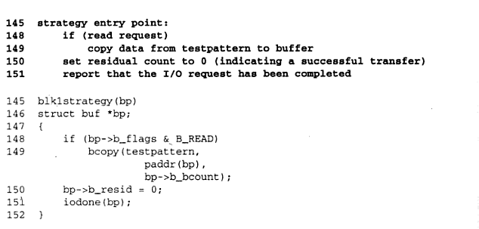

Slide 53
The single parameter is the pointer to the entry in the buffer cache that is to be read or written
The driver checks(line 148) to see if it is a read request, and if so, calls bcopy to copy the contents of the testpattern to the buffer.
The driver then indicates to the driver that the I/O has completed successfully (line 150-151)
Since both the source of the data(testpattern) and the destination (the buffer cache) are in kernel address space.
Unlike copyin/copyout, bcopy always succeed and therefore has no return value.

Slide 54
The Buffer Cache
  The buffer cache is used by kernel to store data that has come from a block device , is going to a block device or both.
  Advantages:
    Allow user processes to perform I/O without regard to the fundamental block structure of the device
    Improves performance of the system (higher average disk throughput by keeping frequently used data in memory)
  Management of buffer cache is handled within the kernel
  Device driver fill or empty buffer as requested.
  Each buffer in the buffer cache is represented by buffer header
  The data structure is defined in the include file/usr/include/sys/buf.h
  and contains information about the contents of the actual buffer

Slide 55
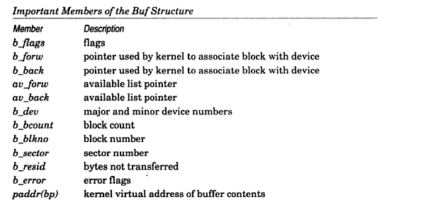

Slide 56
  The b_flags member contains information about the status of the buffer.
  There are only two flags that driver need be concerned about:
    B_READ (which marks a buffer that is to be filled)
    B_ERROR (which the driver sets if I/O fails)
  The b_forw and b_back pointers are used by the kernel to keep the buffer on a doubly linked list of all buffers associated with a single device.
  The more recently used buffers are nearer the end of the list.
  When kernel need a buffer, it takes the first buffer off the front of the available list.
  The av_forw and av_back are used to maintain the list .
  The b_dev member identifies the device.
  The b_count member specifies the number of bytes to be transferred(usually 1024 bytes).

Slide 57
  The location on the disk that is read or written is specified by b_blkno.
  If the driver encounters an error and is unable to complete I/O request, it must put the number of bytes not transferred in b_resid, set the B_ERROR flag in b_flags and put error code from the header file <sys/errno.h> in b_error
  The data associated with buffer header is stored in a separate area referenced by paddr(bp).
The Print Entry Point
  Used by the kernel to report problems related to the driver.
  The entry point only needs to print the error message on the console and usually calls upon the kernel routine cmm_err (an extended version of printf) to display message.

Slide 58
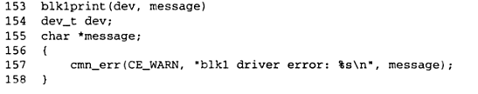

Slide 59
Other block drivers
  A RAM Disk driver
  A SCSI Disk driver

Slide 60
Device driver for PC-Speaker
A Pc Speaker is a loud speaker connected to the computer
Modern computer use piezo-electric speakers
  Piezo electricity is the electric charge which accumulate in certain solid material when mechanical stress is applied
PC Speaker is the first output device which is activated during the boot process.
It uses pulse width modulation

Slide 61
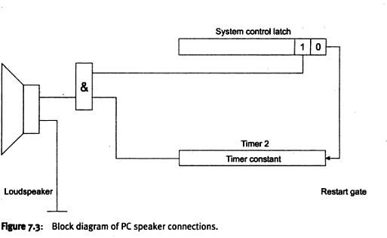

Slide 62


Slide 63
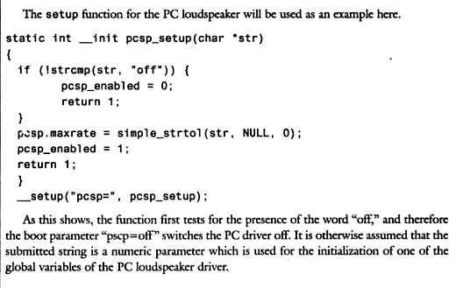

DRIVER ENTRY POINTS

Slide 64
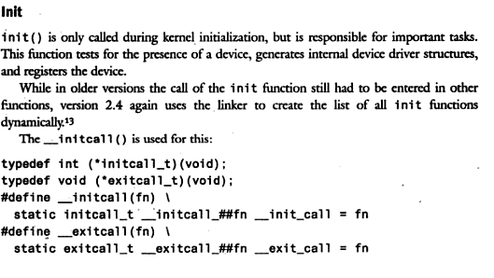

Slide 65

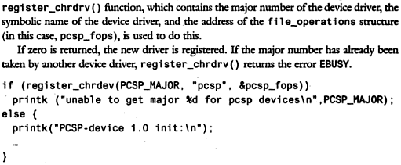

Slide 66



Slide 67
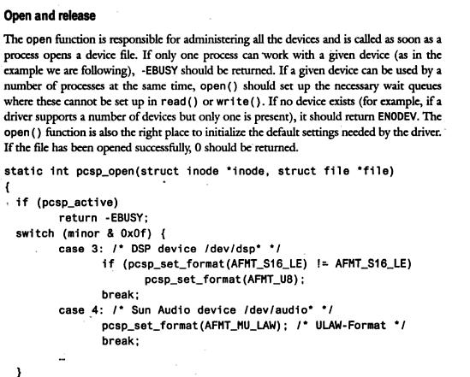
Notes:
Inodes store information about files and directories (folders), such as file ownership, access mode (read, write, execute permissions), and file type.

Slide 68
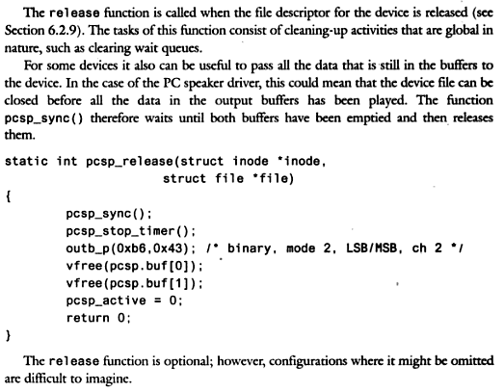

Slide 69
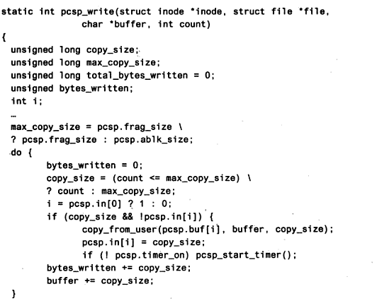

Slide 70
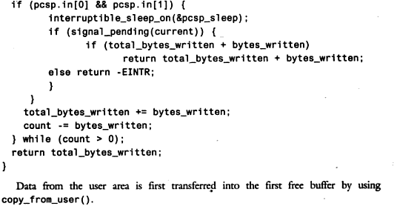

Slide 71
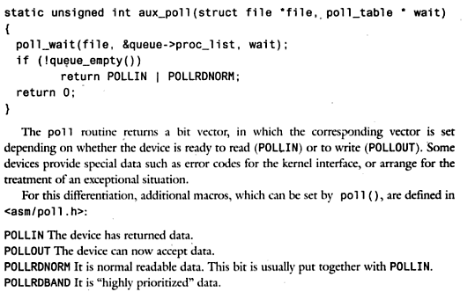

Slide 72
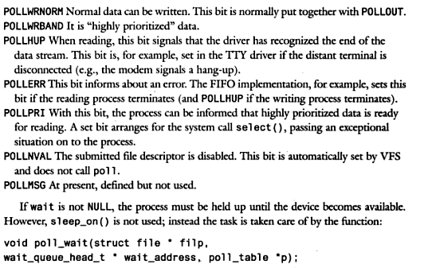

Slide 73



User spaces Vs kernel space

